Slide 1
“Grammatical Profiles: What Inflectional Forms Tell us about Lexicon and Grammar”
Laura A. Janda and Olga Lyashevskaya
CLEAR group at UiT
Cognitive Linguistics: Empirical Approaches to Russian

Slide 2
Overview
Introduction
  What is a Grammatical Profile?
  Tense, Aspect and Mood in Russian
2 Studies of TAM in Russian
  Study 1: prefixes and suffixes
    Are pairs formed via both prefixes and suffixes?
  Study 2: TAM and outlier verbs
    What verbs are most attracted to TAM combinations?
Conclusion
  Perfective vs. imperfective pairs formed with prefixes and suffixes behave the same way
  Grammatical “idioms” in interaction of aspect and inflection

Slide 3
Introduction
Why use grammatical profiles?
  Subset of behavioral profiles (Divjak & Gries 2006, Gries & Divjak 2009)
  Some verbs used in some forms more frequently than others (Šteinfeldt 1970)
  Differences are relevant to TAM

Slide 4
Introduction
What is a grammatical profile?
  Relative frequency distribution of the inflected forms of a word in a corpus
  Take verb X (e.g., delat’ ‘do’) and find out how many times it appears in various forms in a corpus and calculate percentages
  For example, the mean distribution of imperfective verbs in the Russian National Corpus is:
    non-past 42%
    past 30%
    infinitive 15%
    imperative 2%
    gerund 5%
    participles 6%

Slide 5

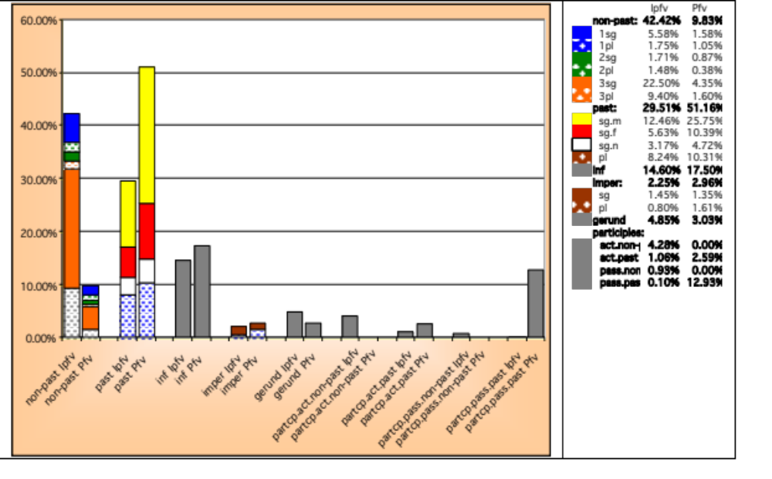

Slide 6
Tense in Russian
Past
Non-Past
  Imperfective = Present tense
  Perfective = Future tense

Slide 7
Aspect in Russian
All forms of all verbs express aspect
  (residue of biaspectual verbs are syncretic)
Two types of verbs in Russian, often referred to as “paired”:
  Perfective
  Imperfective

Slide 8
Mood in Russian
Infinitives used in modal constructions
Russian lacks modal verbs
Mood in Russian can be:
  Indicative
  Infinitive + modals
  Imperative

Slide 9
2 Studies of TAM in Russian
Insights into Russian aspect
  Are aspectual pairs formed only by suffixation (Isačenko) or by both suffixation and prefixation (traditional view)?
  Which verbs characterize various TAM intersections?
    For example, which verbs are used most in a given TAM combination, such as perfective imperative or imperfective non-past?
Study 1
Study 2

Slide 10
Level of Analysis
Subparadigm level (non-past, past, infinitive, imperative) is optimal for study of Russian aspect because it
  yields 85% of total data for verbs after participles and gerunds are excluded
  includes categories acknowledged to interact with aspect (finiteness, mood, tense)
  excludes categories not acknowledged to interact with aspect (person, number, gender)

Slide 11
Major Patterns of Russian aspectual morphology
Simplex verbs
  nearly all imperfective (delat’ ‘do’)
Prefixed verbs (prefix + simplex)
  nearly all perfective (sdelat’ ‘do’, peredelat’ ‘redo’)
Prefixed and suffixed verbs (prefix + simplex + suffix)
  secondary imperfectives (peredelyvat’ ‘redo’)

Slide 12
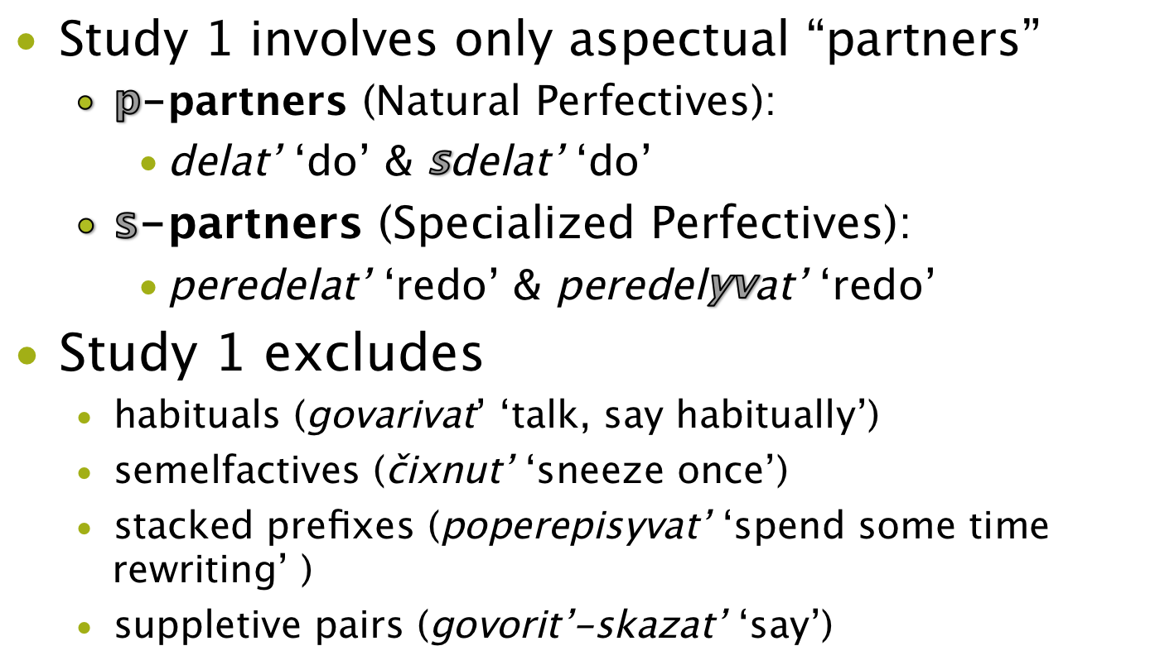
Aspect Study 1: prefixes & suffixes

Slide 13
Aspect Study 1: prefixes & suffixes
Traditional hypothesis
  both p-partners and s-partners form aspectual pairs
Corollary
  p-partners and s-partners should behave the same
Isačenko hypothesis
  only s-partners form aspectual pairs
Corollary
  p-partners and s-partners should behave differently
The corollaries can be tested empirically

Slide 14
Aspect Study 1: prefixes & suffixes
Databases of p-partners and s-partners
  Based on Modern subcorpus (1950-2007; 92M words) of Russian National Corpus
  Excludes all verbs with <100 attestations
p-partners: 264 pairs, over 1.6M forms
  Based on Exploring Emptiness database at UiT
  http://emptyprefixes.uit.no/index.php
  Excludes verbs with multiple prefixes, biaspectual verbs, homonomy
s-partners: 1,311 pairs, over 4.3M forms
  Based on Zaliznjak 1980

Slide 15
Aspect Study 1: prefixes & suffixes
Table 1: Imperfective vs. Perfective verbs
  Statistically significant: chi-squared = 947756, df = 3, p-value < 2.2e-16
  With nearly 6M datapoints, too much statistical power
  Effect size moderate/large: Cramer’s V = 0.399
  (0.1 = small, 0.3 = moderate, 0.5 = large)

Slide 16
Aspect Study 1: prefixes & suffixes
Table 2: p-partners vs. s-partners
  Imperfectives: chi-squared = 16155.13, df = 3, p-value < 2.2e-16, but Cramer’s V = 0.076, below “small”
  Perfectives: chi-squared = 4365.078, df = 3, p-value < 2.2e-16, but Cramer’s V = 0.037, below “small”
  (0.1 = small, 0.3 = moderate, 0.5 = large)
  See Figure 1 on handout (p. 2)

Slide 17
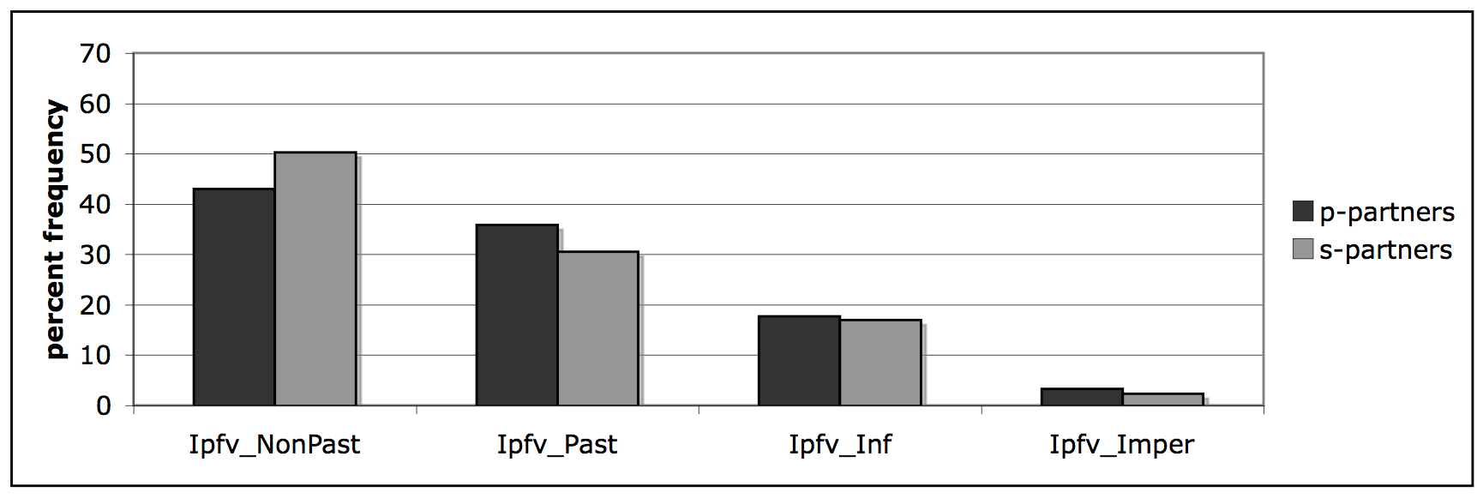
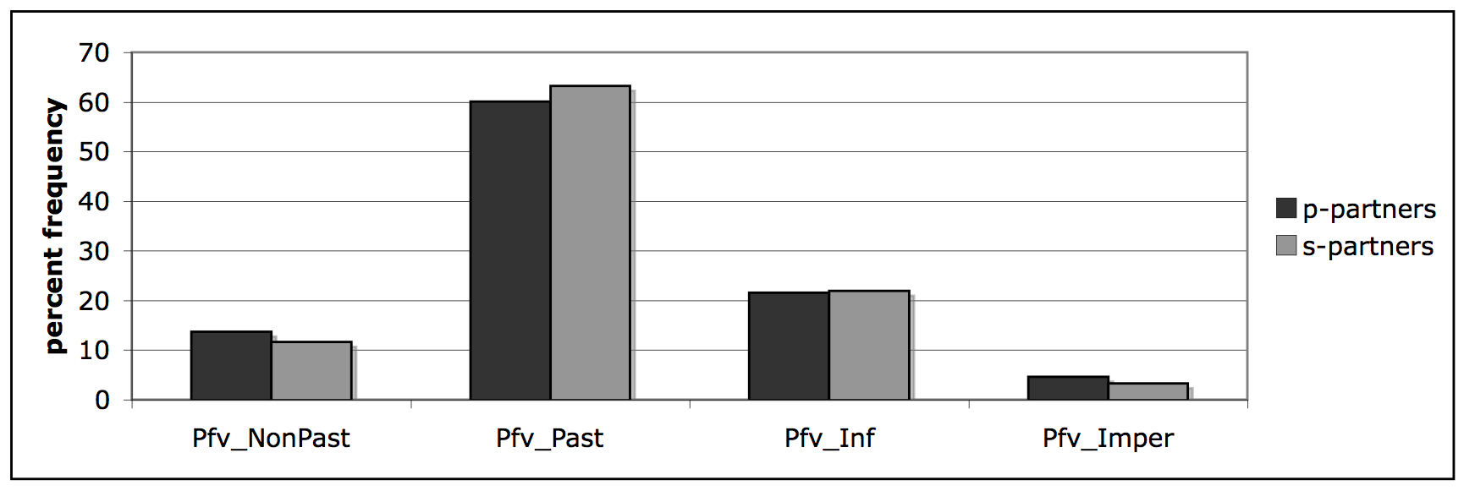

Slide 18
Aspect Study 1: prefixes & suffixes
No real difference between p-partners and s-partners
No support for Isačenko hypothesis
Since p-partners and s-partners behave the same, we merge data from both types in Study 2.

Slide 19
Aspect Study 2: TAM & outlier verbs
Hypothesis for each TAM combination based on previous scholarship
We look at outlier verbs for each combination of imperfective vs. perfective with imperative, non-past, infinitive, and past
Outlier verbs are statistically deviant, strongly attracted to (or repulsed by) a given TAM combination
We also sampled verbs from mid- and bottom-range

Slide 20
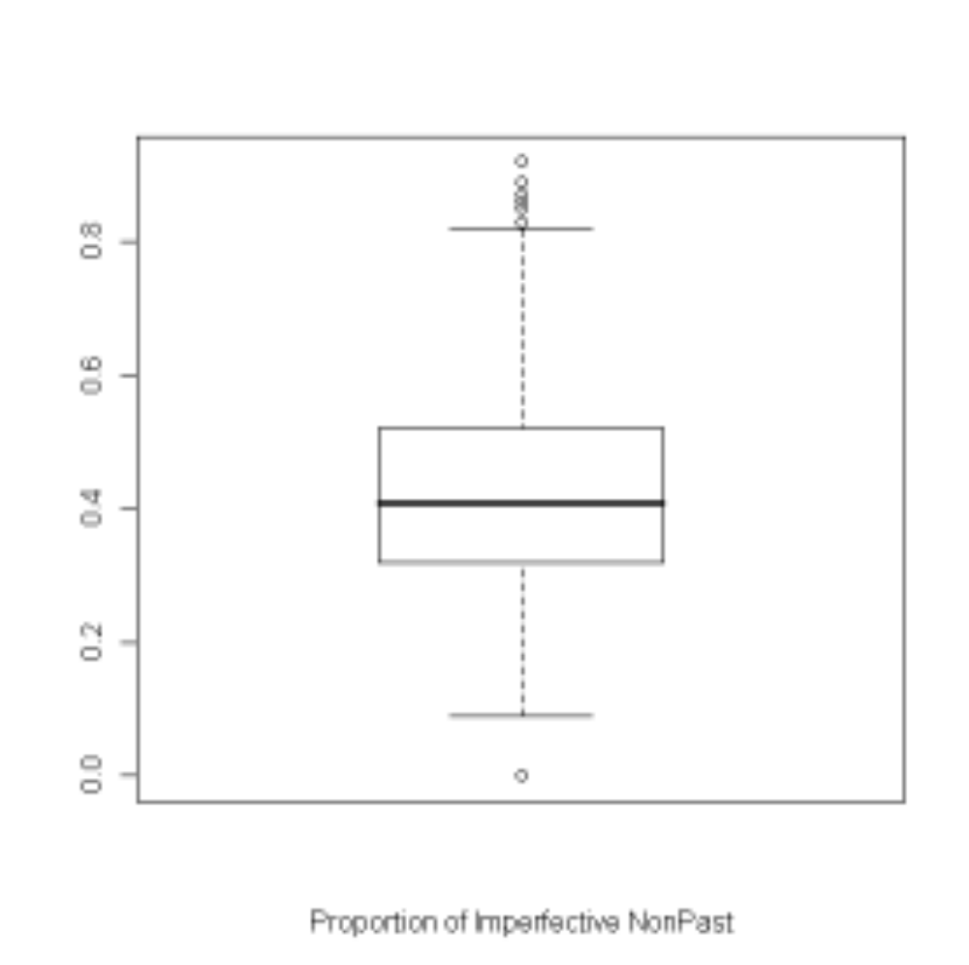
outliers
+ 1.5 times interquartile range
interquartile range
median
- 1.5 times interquartile range
outlier

Slide 21
Imperfective imperative “be doing X!”
  Hypothesis:
    In comparison with Perfective imperative, it denotes
      categorical negation
      politeness
      insistence (rudeness)
  Hypothesis confirmed, but other findings too

Slide 22
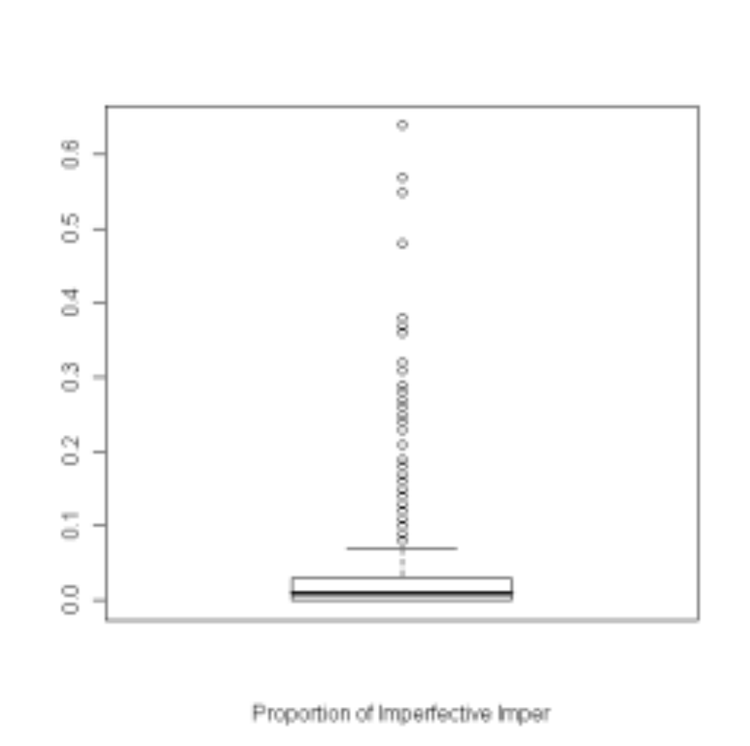

Slide 23
Imperfective imperative
Over 200 outliers
Polite: guest knows what to expect: razdevajtes’ ‘take off your coat’, sadites’ ‘sit down’, prisoedinjajtes’ ‘join in’, zakusyvajte ‘eat a chaser’, zakurivajte ‘have a smoke’, zaezžajte ‘stop by’, zalezajte ‘get into the car’
Insistence: hearer is hesitant: stupajte ‘get going’, gljadite ‘look’, zabirajte ‘take’
Insistence: hearer has not behaved properly (connection with negation): provalivaj ‘get out of here’, končaj ‘stop’, ne perebivaj ‘don’t interrupt’, ne prikidyvajsja ‘don’t pretend to be something you aren’t’, ne peredergivaj ‘don’t distort the facts’, otvalivaj ‘get out of here’

Slide 24
Imperfective imperative
Other findings
  Polite requests: vyručajte ‘help’
  Kind wishes: vyzdoravlivajte ‘get well’
  Conventional construction: davajte ‘let’s/let me’ (posmotrim ‘take a look’, pomogu ‘help’, rasskažu ‘tell’, pokažu ‘show’, sdelaju ‘do’)
  Idiomatic/culturally anchored: proščaj(te) ‘farewell’, soedinjajtes’ ‘unite’ (slogan), obogoščajsja ‘be prosperous’ (NEP), zapevaj ‘sing’ (army), ne pominaj lixom/kak zvali ‘bear no ill will/they just vanished’, spasajsja, kto možet ‘every man for himself’, na čužoj karavaj rot ne razevaj ‘don’t take others’ belongings’
Notes:
давай(те) takes hearer’s perspective

Slide 25
Perfective imperative “make X happen!”
Hypothesis
  Rude
  Instructions
  Warnings
  Hypothesis confirmed for rude and instructions, but not for warnings, and there are other findings too

Slide 26
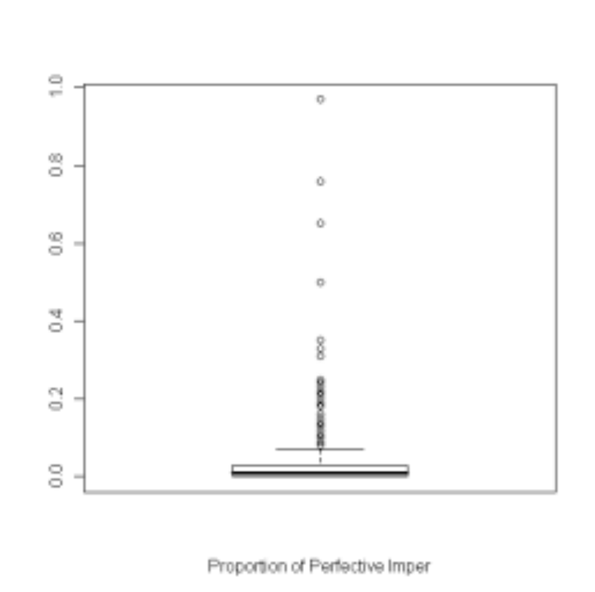

Slide 27
Perfective imperative
Over 300 outliers
Rude: otstan’ ‘leave me alone’, otpustis’ ‘let me go’, perestan’ ‘stop it’
Instructions: (cooking) vskipjatite ‘boil’, (exercising) sognite ‘bend’, (official transactions) raspišites’ ‘sign for’, (text instructions) rassmotrite [grafik x] ‘see [figure x]’
Additional findings
Polite expressions: izvinite ‘excuse me’, poterpite ‘please be patient’, predstav’te ‘imagine’
Attention-directing: posmotrite ‘look at’, vslušajtes’ ‘listen to’, ponjuxajte ‘sniff’, ugadajte ‘guess’
Notes:
давай(те) takes hearer’s perspective

Slide 28
Perfective imperative
Additional findings, cont’d.
Discourse markers: požaluj ‘perhaps’, razrešite ‘allow’, podskažite ‘prompt, tell’, uvol’te ‘spare’
Religious: Gospodi pomiluj ‘Lord have mercy’, blagoslovi otče ‘Father bless’
Conventional construction: dajte ‘let me’ (poceluju ‘kiss’, posmotrju ‘take a look’, vzgljanu ‘take a peek’
Idioms: xot’ zalejsja/zavalis’ ‘a very large amount’, ne razlej voda ‘really close friends’, čert razderi ‘to hell with it’
Notes:
давай(те) takes hearer’s perspective

Slide 29
Imperfective non-past “is doing X”
Hypothesis
  On-going processes
  Concrete processes with a duration
  Simultaneous processes
  Repeated actions
  Hypothesis NOT confirmed – gnomic situations instead

Slide 30
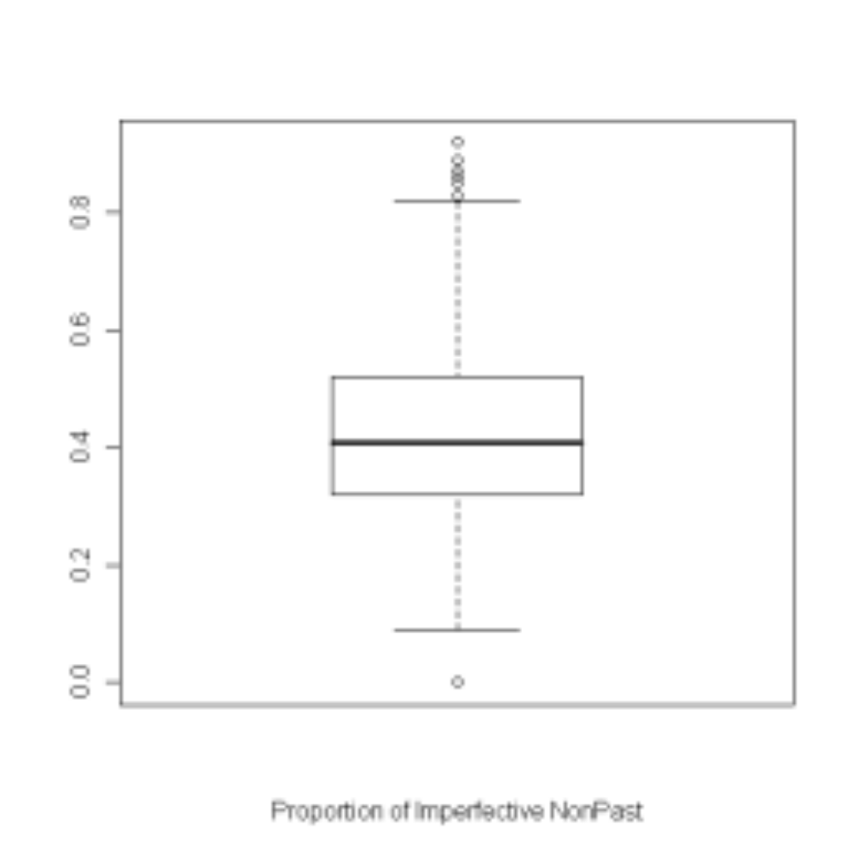

Slide 31
Imperfective non-past
10+1 outlier verbs (slyxat’ ‘hear’ lacks non-past)
10 used in gnomic constructions:
    diskussija vsegda javljaetsja naibolee produktivnoj formoj naučnogo obsuždenija problemy ‘a discussion is always the most productive form for scholarly debate on an issue’
    dannoe obstojatel’stvo vlečet za soboj negativnye posledstvija ‘this situation entails negative consequences for the clients’
    okazyvaetsja ‘turns out to be’; vyjasnjaetsja, čto ‘it turns out that’; čto kasaetsja ‘as far as X is concerned’; storony objazujutsja ‘the parties are obliged to’; zatrudnjajus’ otvetit’ ‘not sure’

Slide 32
Perfective non-past “will get X done”
Hypothesis
  Predicted actions
  Promised actions
  Hypothesis is confirmed, but there are other findings too

Slide 33
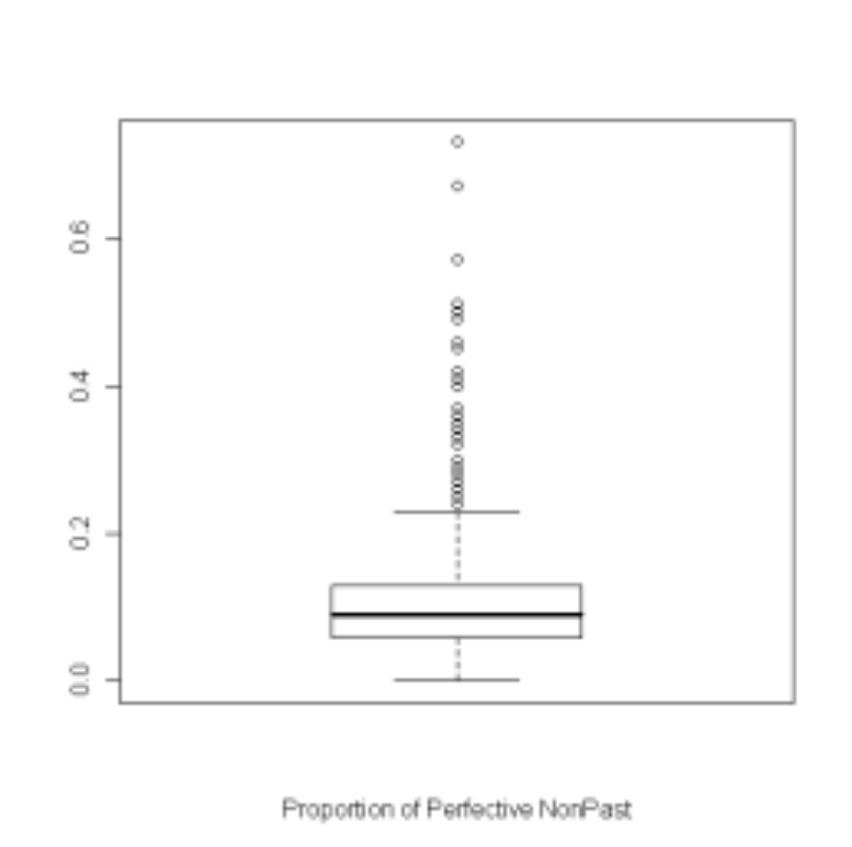

Slide 34
Perfective non-past
84 outlier verbs
Predictions: prevysit ‘will exceed’, umen’šitsja ‘will decrease’, prodlitsja ‘will last’, naladitsja ‘will work out well’, vyzdoroveet ‘will get well’, zatrudnit ‘will make things difficult’, razoritsja ‘will go broke’, potrebuetsja ‘will be necessary’, podoxnet ‘will die’, pridetsja ‘will be necessary’, (ne) obojdetsja (bez) ‘will (not) manage (without)’
Promises: upravitsja ‘will take care of something’, postaraetsja ‘will try’, rasterzaet ‘will tear to pieces’, prokljanet ‘will curse’
Performatives: osmeljus’ ‘I will take the liberty of’, procitiruju ‘I quote’
Idioms: ne pridereš’sja ‘don’t find fault with’, ostal’noe priložitsja ‘the rest will come’, ot tebja ne ubudet ‘nothing is going to happen to you’, vragu ne poželaeš’ ‘I wouldn’t wish it on my worst enemy’

Slide 35
Imperfective infinitive “to be Xing”
2 hypotheses
  Šmelev & Zaliznjak (2006): Imperfective used when action is controllable
  Divjak (2009): Imperfective has generic interpretation
  Divjak’s hypothesis is confirmed

Slide 36
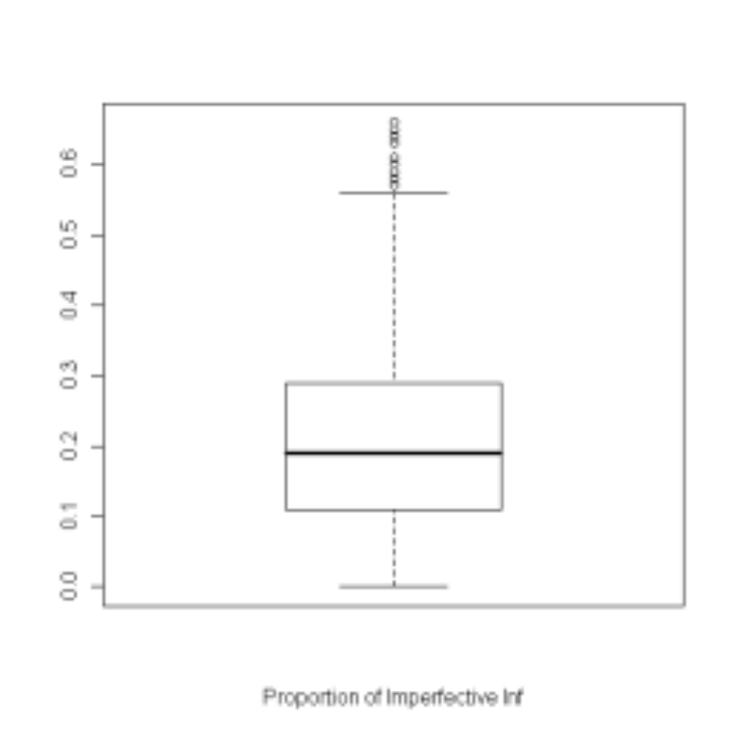

Slide 37
Imperfective infinitive
12 outlier verbs
1 is idiomatic: mne plevat’ ‘I don’t give a damn’
Others used in modal constructions
Our data supports Divjak
  outlier verbs include uncontrollable actions: vvjazyvat’sja ‘get mixed up in’, raspoznavat’ ‘recognize, identify’, soglasovyvat’ ‘conform to, agree with’
  outlier verbs target conformist behavior: sobljudat’ ‘conform to’, peredelyvat’ ‘redo’, ispravljat’ ‘repair’, učityvat’ ‘take into account’

Slide 38
Perfective infinitive “to get X done”
2 hypotheses
  Šmelev & Zaliznjak (2006): Perfective used when action is controllable
  Divjak (2009): Perfective has specific interpretation; also used with “tentative verbs”, čtoby ‘in order to’ construction and adverbs describing difficulty/importance of achieving X
  Divjak’s hypothesis is confirmed

Slide 39
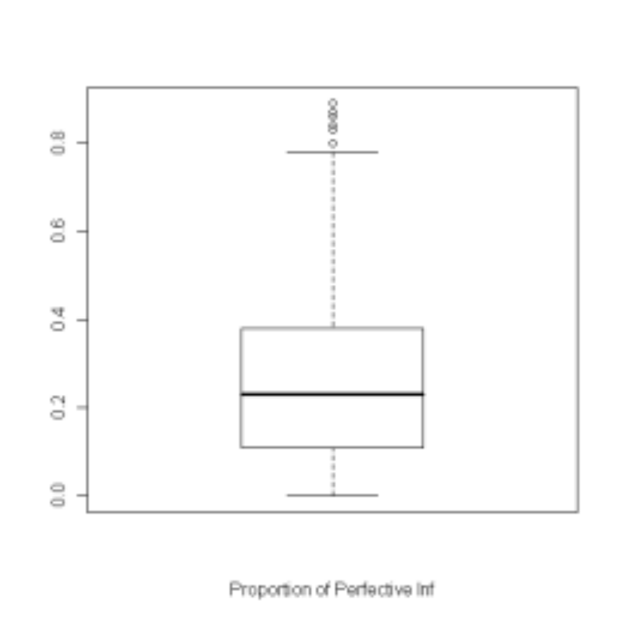

Slide 40
Perfective infinitive
12 outlier verbs (mne naplevat’ ‘I don’t give a damn’)
Modal uses for specific situations
Tentative verbs:
  Poètomu my popytaemsja vospolnit’ ètot probel, opirajas’ na fakty i cifry. ‘That is why we are trying to fill in that gap, relying on facts and figures.’
Čtoby ‘in order to’ construction:
  Posle zanjatija možno vypit’ vody, čtoby vospolnit’ ee poterju. ‘After working one can drink some water in order to make up for its loss.’
Adverbs describing difficulty/importance
  Fruktami istinnyj deficit kalija vospolnit’ očen’ tjaželo, praktičeski nevozmožno. ‘It is very difficult, practically impossible, to make up for a real calcium deficit by [eating] fruit.’

Slide 41
Imperfective past “was X-ing”
Hypothesis
  Durative past actions
  Repeated past actions
  Hypothesis is confirmed, but there are other findings too

Slide 42
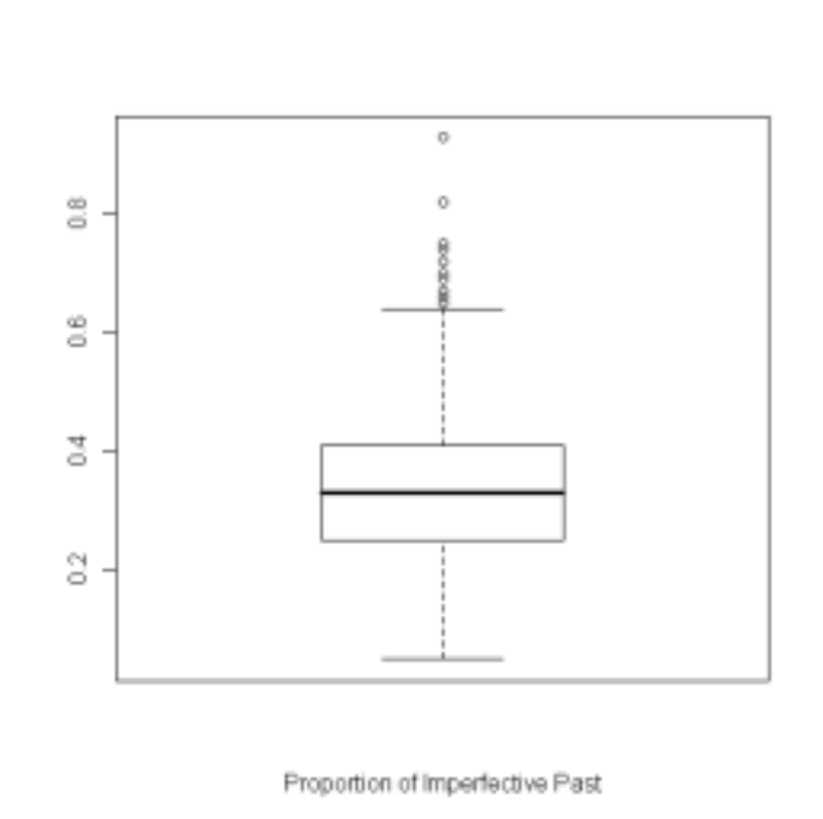

Slide 43
Imperfective past
13 outlier verbs
Evidentials: slyxal, slyl ‘heard’
Defective paradigms: 10 of these verbs have no imperative
Narration of observations: belel ‘showed white’, černel ‘showed black’, mračnel ‘showed dark’, svešivalsja ‘hung, dangled’
Negation for categorical statements: ne pomyšljal ‘not thought about, dreamt of’, ne unimalsja ‘there was no stopping X’
Behaviors accompanying dialog: ščurilsja ‘squinted’, otšučivalsja ‘made joking replies’, mračnel ‘glowered’

Slide 44
Perfective past “Xed, got X done”
no outlier verbs

Slide 45
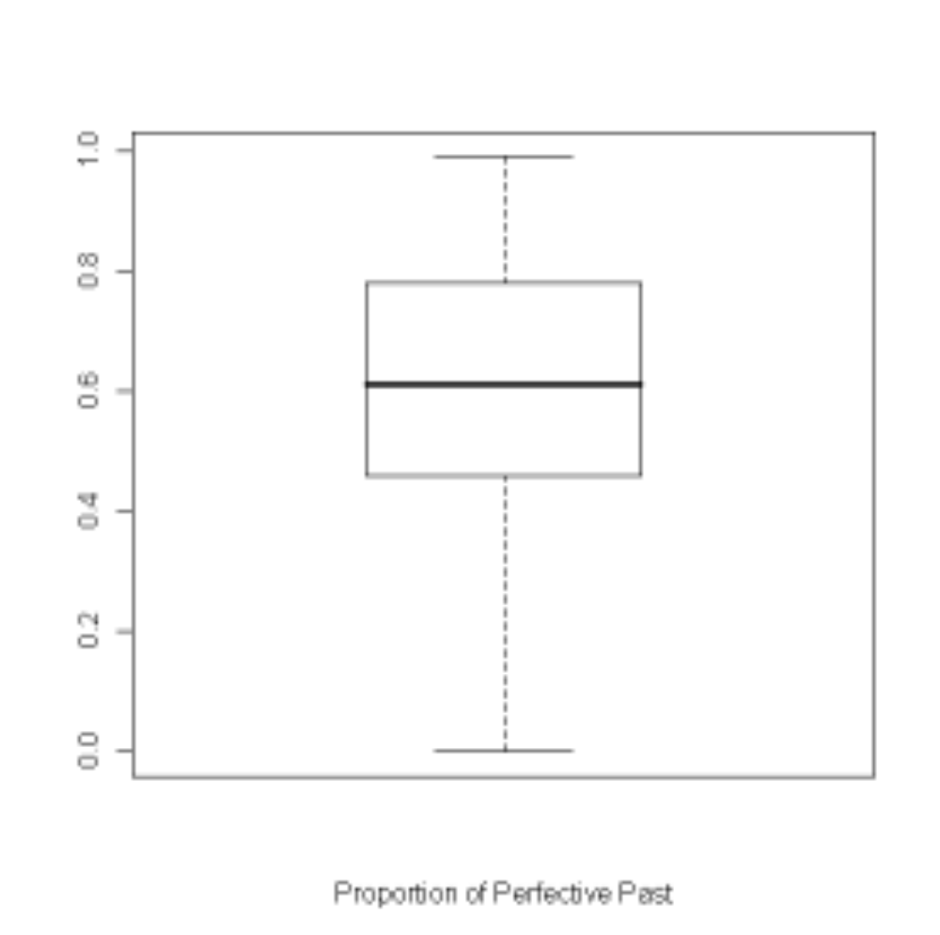

Slide 46
Conclusions
Aspectual pairs behave similarly, regardless of whether they are formed via suffixation or prefixation
  It may be that meanings of prefixes and verbs overlap
Outlier verbs support some previous scholarship, but also present new insights and challenges

Slide 47
Conclusions
Imperfective imperative
  extend list of typical polite and rude expressions; added familiar uses
Perfective imperative
  new details on rude and neutral uses; added polite uses and use for attention-directing
Imperfective non-past
  gnomic reference (instead of ongoing-durative)
Perfective non-past
  predictions of improvements/problems, threats, promises, performatives

Slide 48
Conclusions
Imperfective & Perfective infinitive
  Mainly modal uses
  Imperfective infinitives express generic circumstances
  Perfective infinitives express specific situations (both circumstances and physical necessity/capacity); constructions with tentative verbs, adverbs, čtoby ‘in order to’
Imperfective past
  evidentials, habituals, narration of observations

Slide 49
Impact
Better linguistic analysis
Pedagogical applications

